Slide 1
Virtual Box
Setup Ubuntu

Slide 2
Minimum Requirements
RAM: 4 GB
25 GB free disk space
CPU: 2 cores
Ubuntu ISO image
VirtualBox with extension pack

Slide 3
Ubuntu Installation
Downloading link for the updated version of ubuntu
https://ubuntu.com/download/desktop

Slide 4
System Requirements
Windows 10
CPU: +1 GHZ and 2 or more cores
RAM: 4 GB (Recommended 8 GB)
Disk Space: 20 GB free disk space

Slide 5
Installation of VirtualBox

Slide 6
Step #01: Click on the downloading link
Downloading link for the updated version of Download VirtualBox and Expansion Pack:
https://www.virtualbox.org/wiki/Downloads

Slide 7
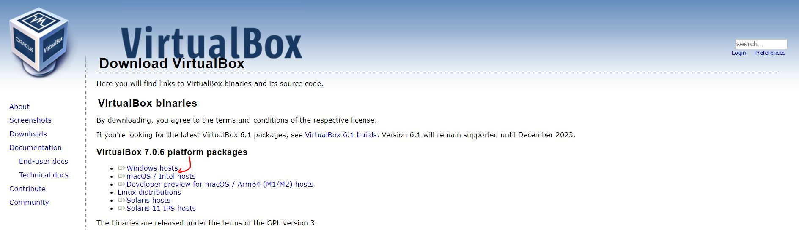
Step # 01: Click on windows hosts

Slide 8
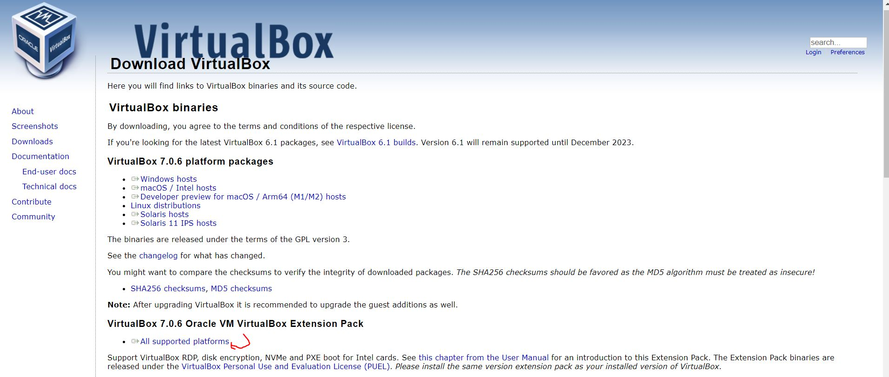
Step #03:Download Extension Pack
Click the All supported platforms to Download the Extension pack

Slide 9
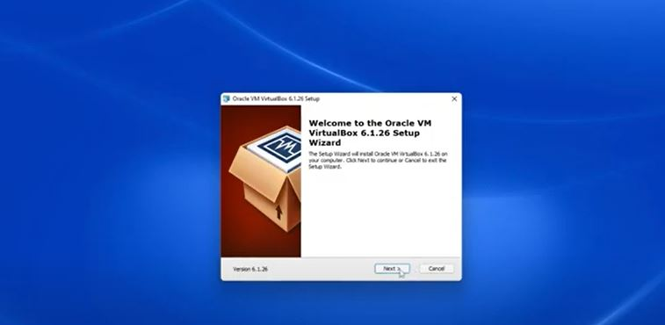
Step #04: Right Click on the download file and Run as Administrator
Step #05: Just Click Next
Next Steps: Now just install the virtual box as normally

Slide 10
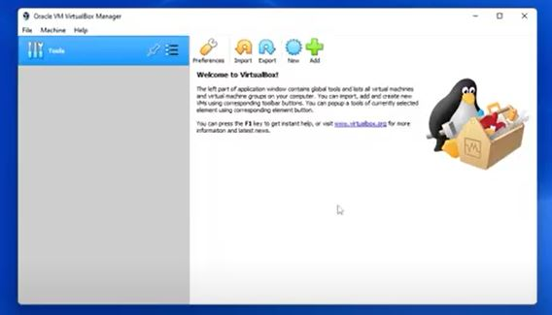
Installation of Extension Pack
Step #01: Open VirtualBox

Slide 11
Installation of Extension Pack
Step #02: Click on the preferences Icon in the VirtualBox

Slide 12
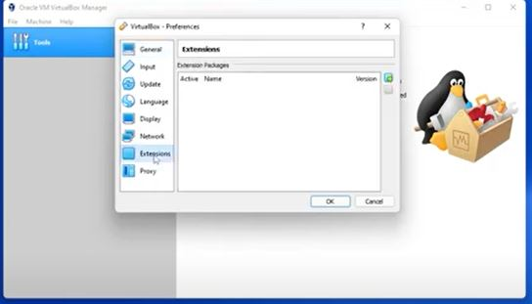
Installation of Extension Pack
Step #03: Then click on the extension in the Menu

Slide 13
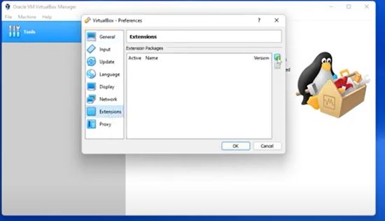
Installation of Extension Pack
Step #04: Click on the + sign at the right

Slide 14
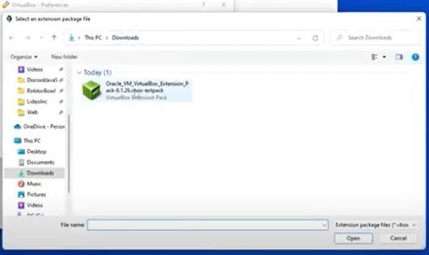
Installation of Extension Pack
Step #05: Add the Downloaded
Extension Pack
Next Steps: Just click install and Agree the Agreements, Then a successful Notification will occur on the screen

Slide 15
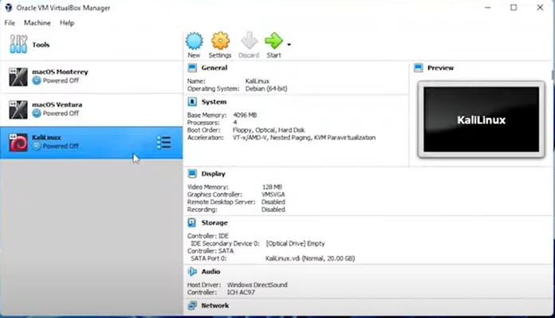
Installation of Ubuntu
Step #01: Open VirutalBox
Step #02: Click on the New Icon

Slide 16
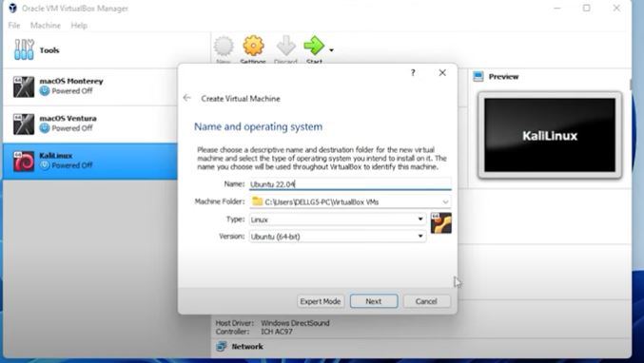
Step #03: Create a new Virtual Machine as below

Slide 17
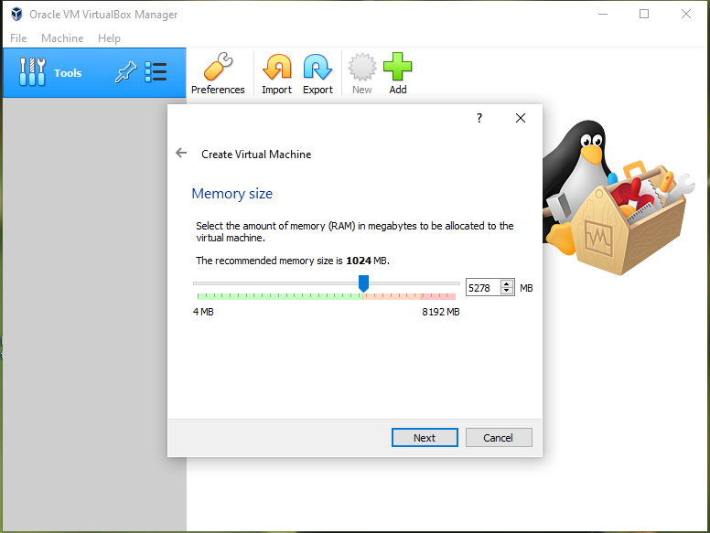
Step #04: Provide RAM space

Slide 18
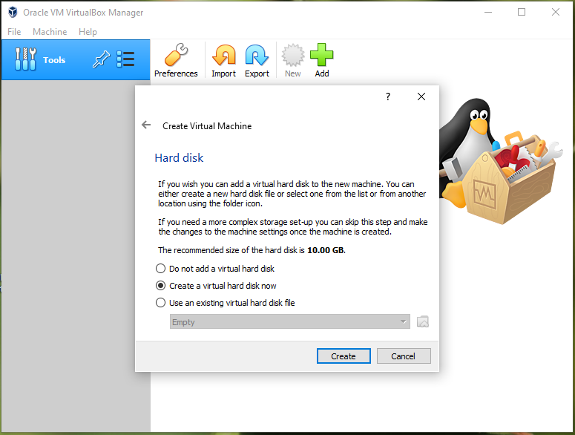
Step #05: Select “Create a virtual hard disk now” then click on create

Slide 19
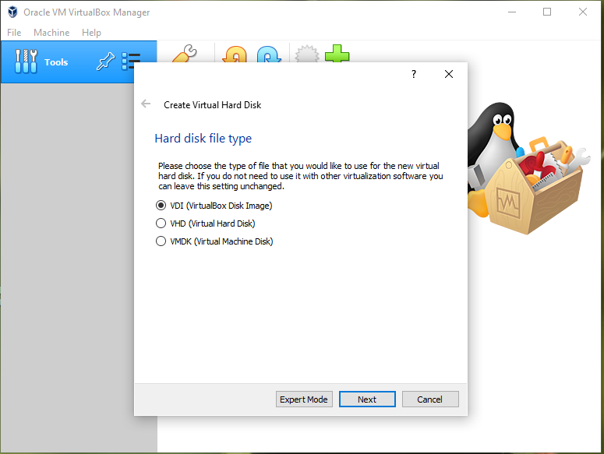
Step #06: For the Hard Disk file type just select the “VDI ” then click next

Slide 20
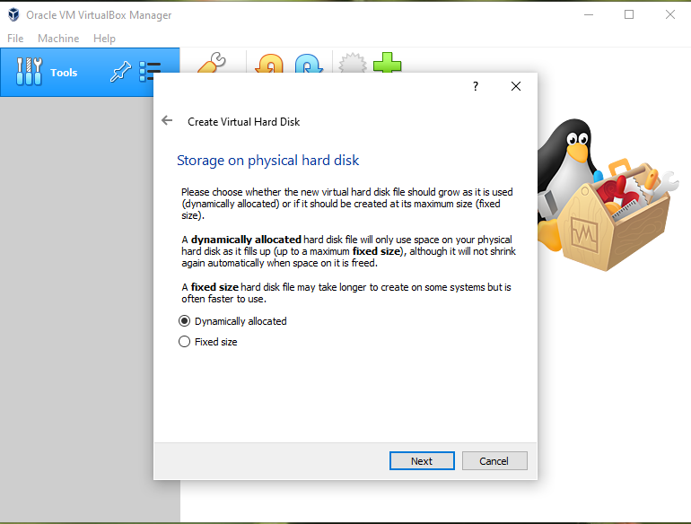
Step #07: For the Storage on the physical Hard Disk just select Dynamically Allocated then click Next

Slide 21
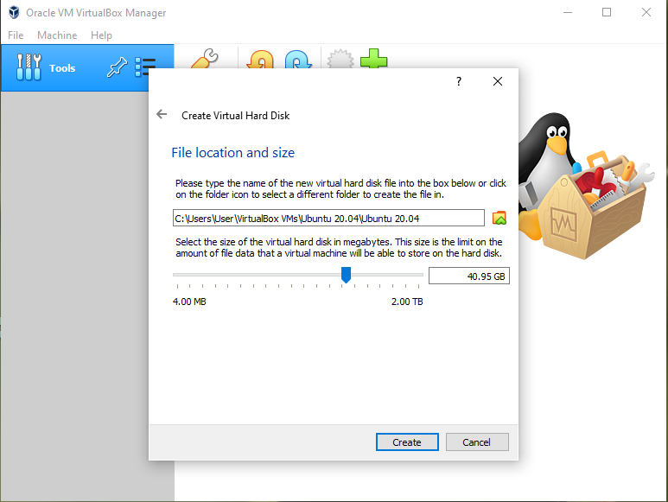
Step #08: The file location is default and the increase the size to 30 GB

Slide 22
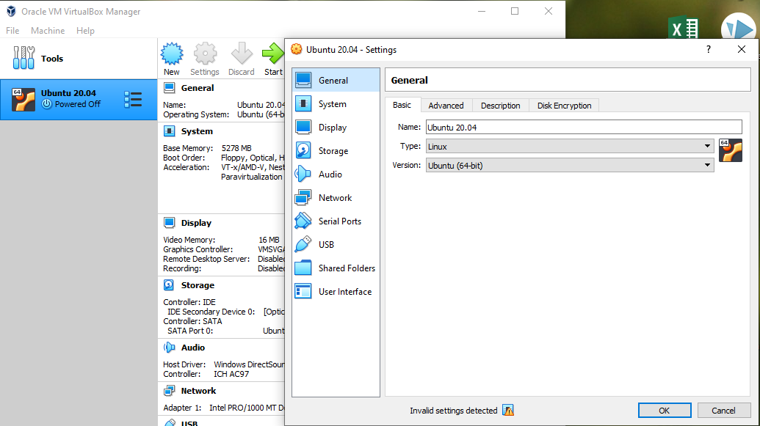
Step #09: Select the Virtual Machine and click on the Settings

Slide 23
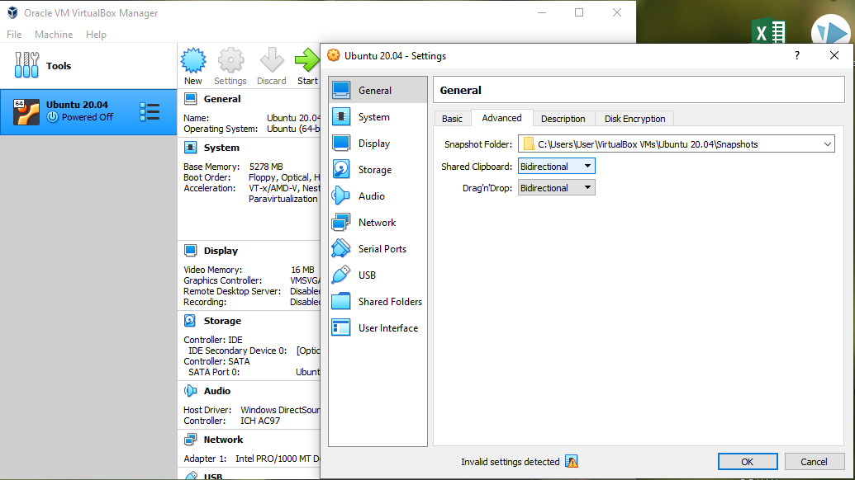
Step #10: Just make the General as show in the screenshot

Slide 24
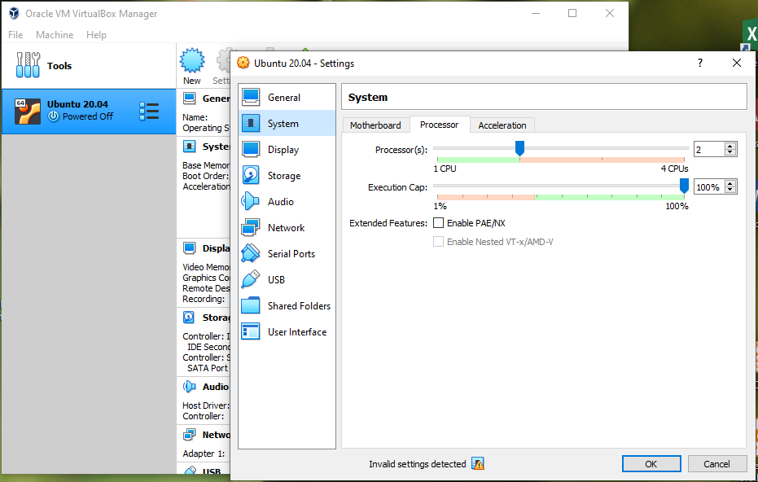
Step #11: In the System make it according to the screenshot

Slide 25
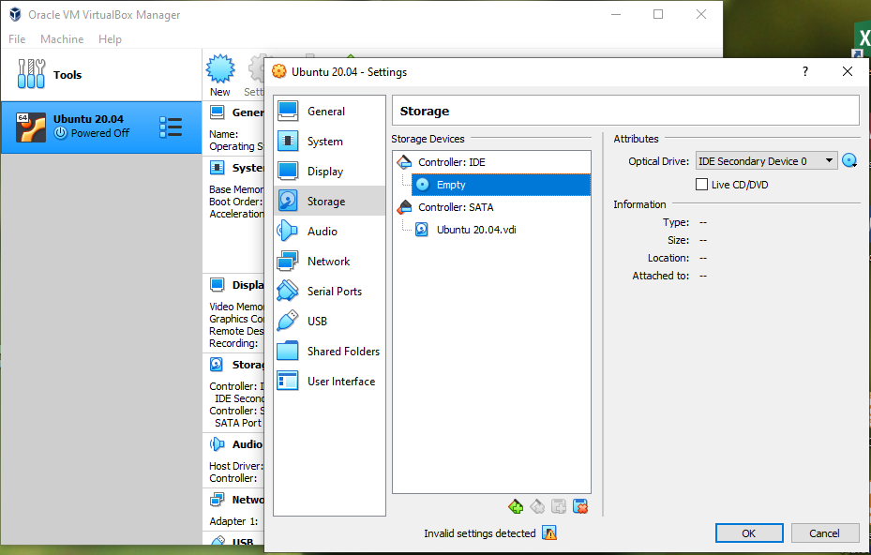
Step #12: In the Storage Click on the empty

Slide 26
Step #13: In the Optical Drive just click on the CD disk-like icon on the right

Slide 27
Step #14: Choose the disk file, select the iso image of ubuntu

Slide 28
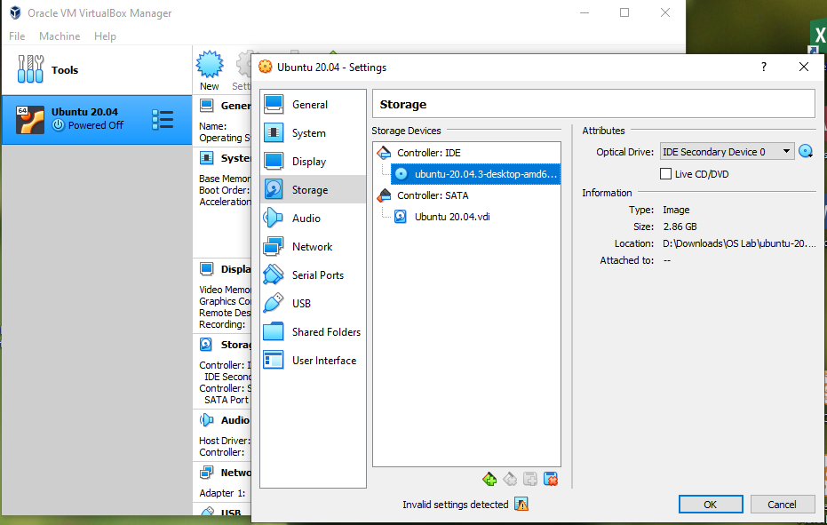
Step #15: Once the ISO image is selected then click on ok

Slide 29
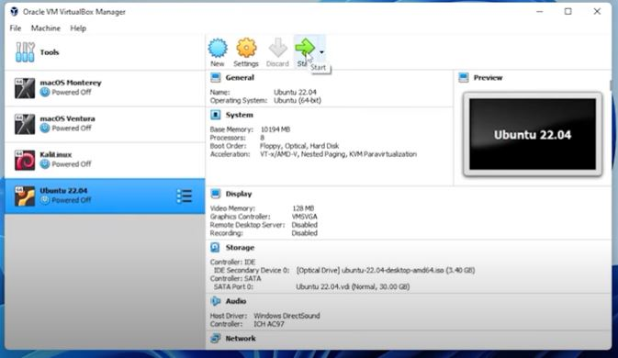
Step #16: In the VirtualBox select the virtual machine and click on start Button

Slide 30
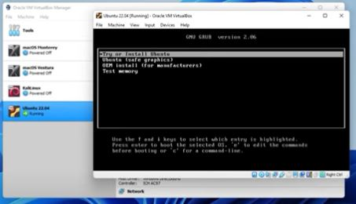
Step #17: Click on Try or Install Ubuntu and Click on Enter from the keyboard

Slide 31
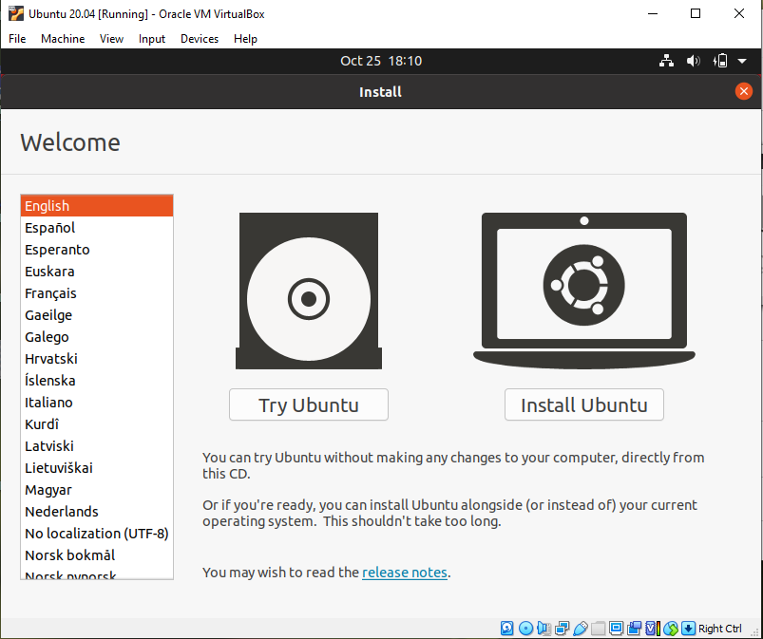
Step #18: Select English and Click on Install Ubuntu

Slide 32
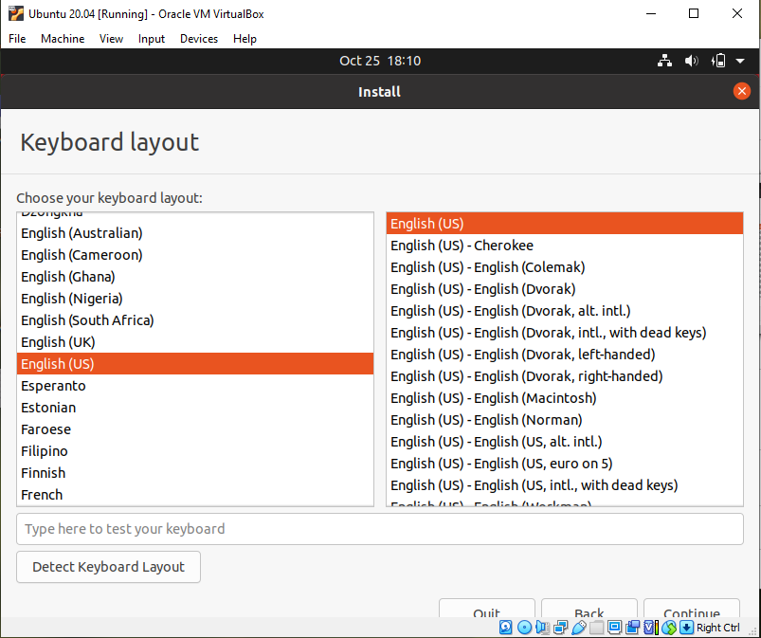
Step# 19: Select English at both windows and click on continue

Slide 33
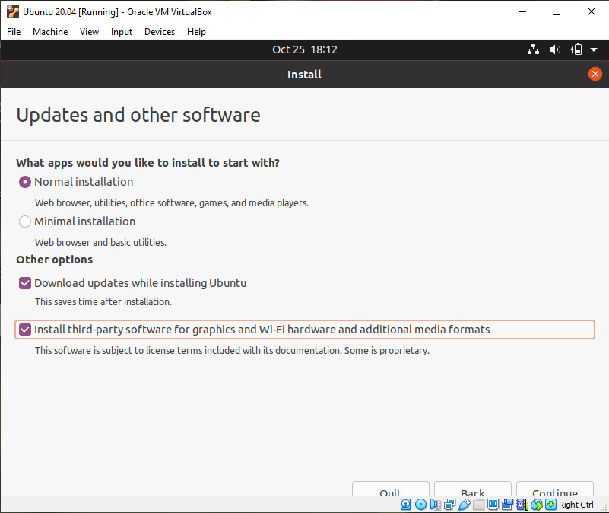
Step #20: Select the Noraml Installation and Download Update while Installing Ubuntu, then click continue

Slide 34
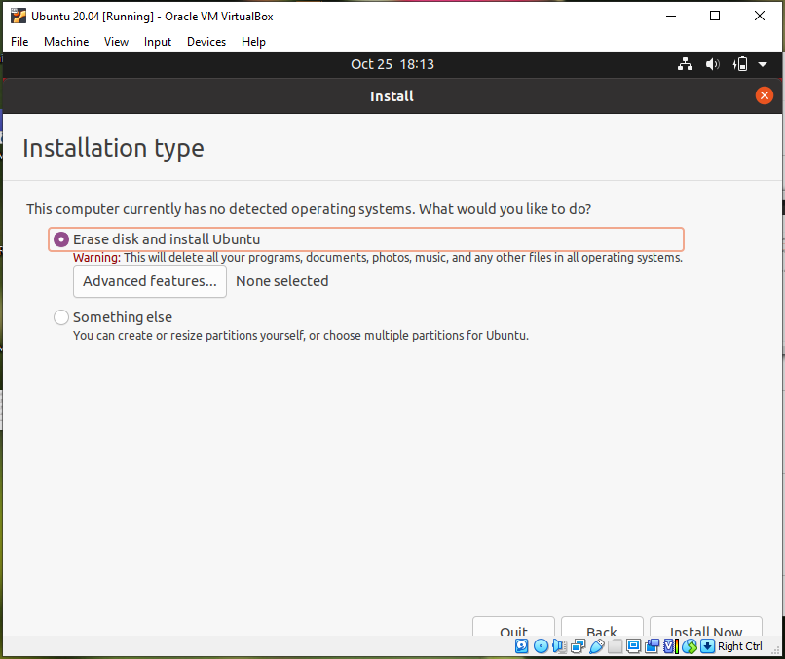
Step #21: Select the Erase disk and install Ubuntu then click Install Now

Slide 35
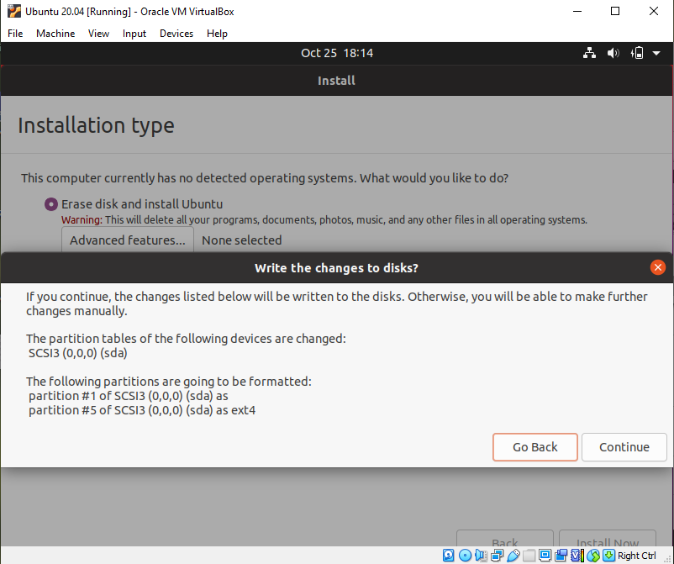
Step #22: Click on Continue

Slide 36
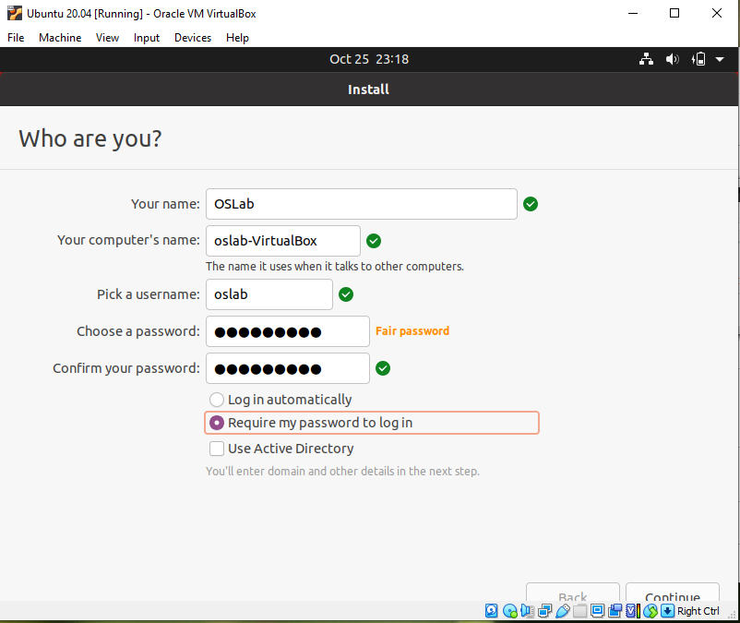
Step #23: Make your profile and click continue

Slide 37
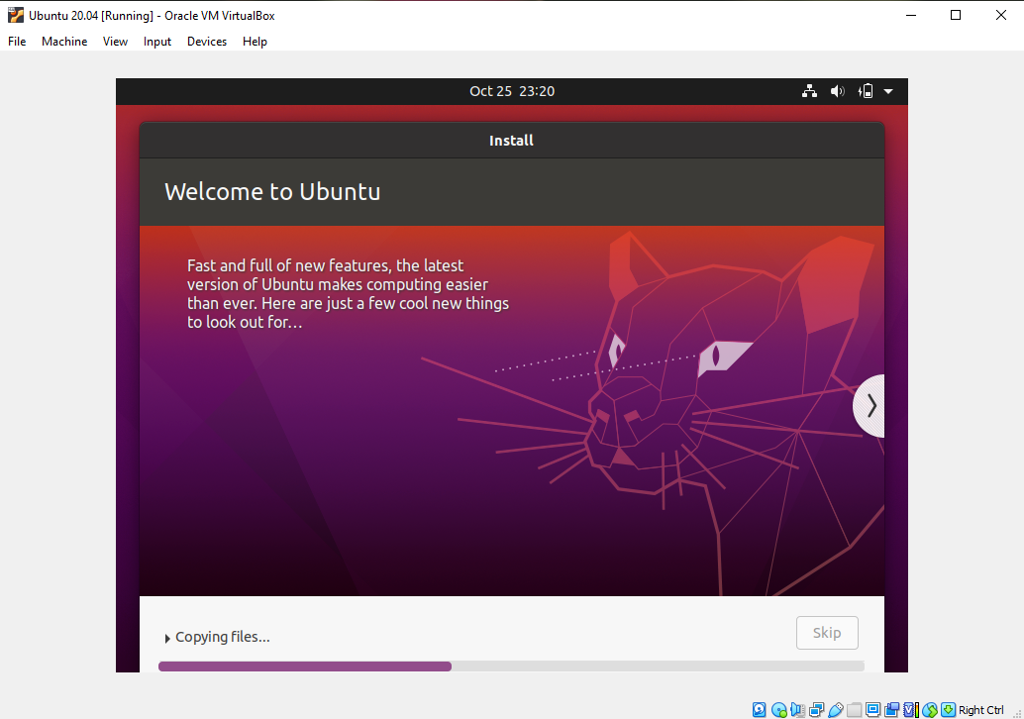
Installation starts

Slide 38
Once the installation completed just restart
Make the different changes or skip and continue

Slide 39
Go to the menu click on the terminal
Write $ sudo apt update
Type your password
$ sudo apt install –y build-essential linux-headers-$(uname -r)
Once these commands are run then close the terminal

Slide 40
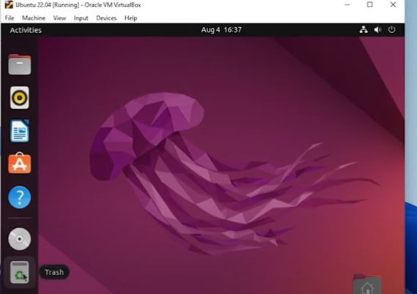
Go to the Devices menu on the top there is “Insert Guest Addition CD image” click on it
The disk will appear at the lift side as shown in the screenshot

Slide 41
Double click and open it.
Find a file named “autorun.sh” right click on it and click on Run as Program
Type your password
The Guest addition installation will start
Then close the windows and just restart the system
Then click on the fullscreen

